Slide 2
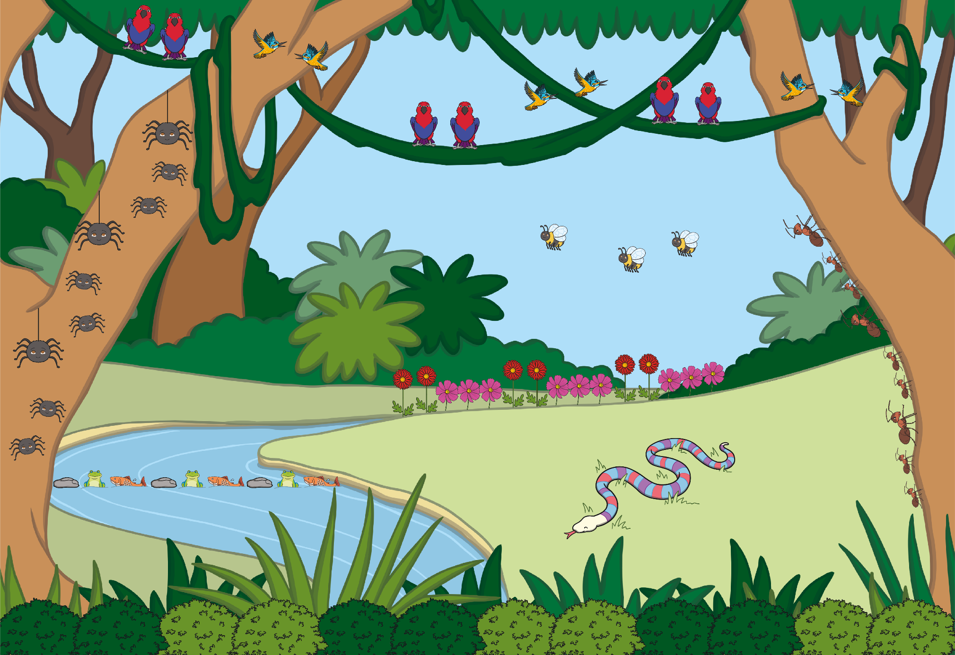

Slide 3
back to the picture
next

Slide 4
back to the picture
next

Slide 5
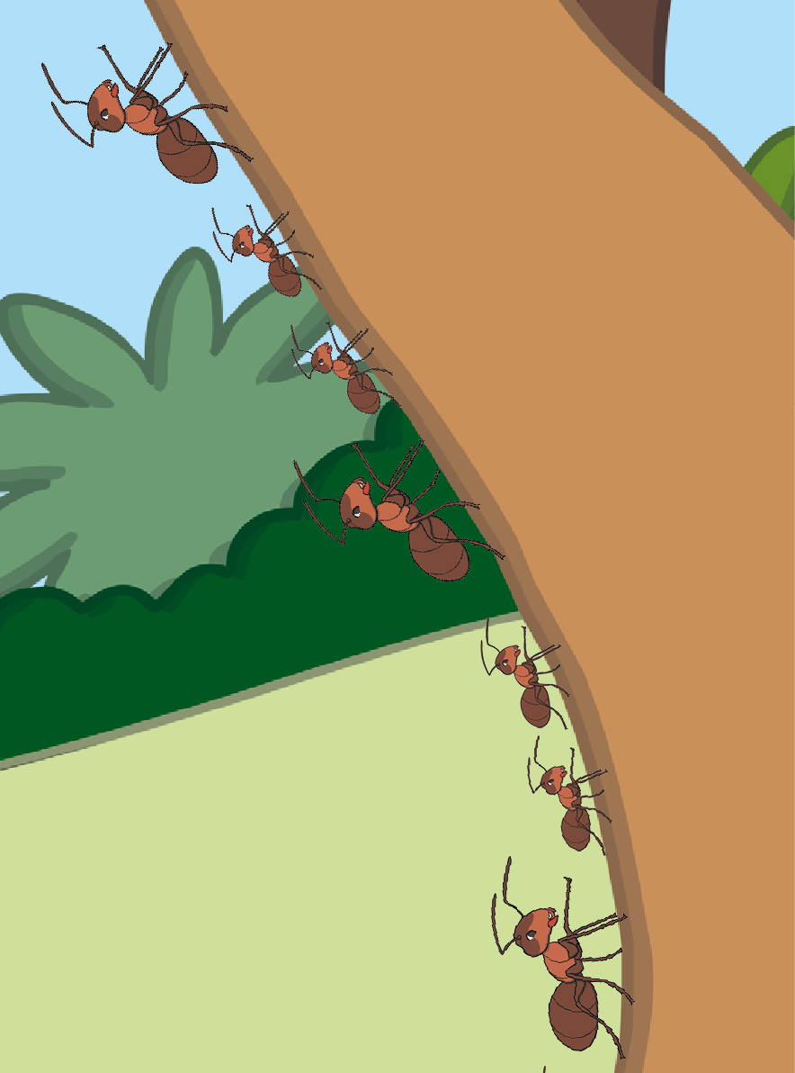
back to the picture
next

Slide 6
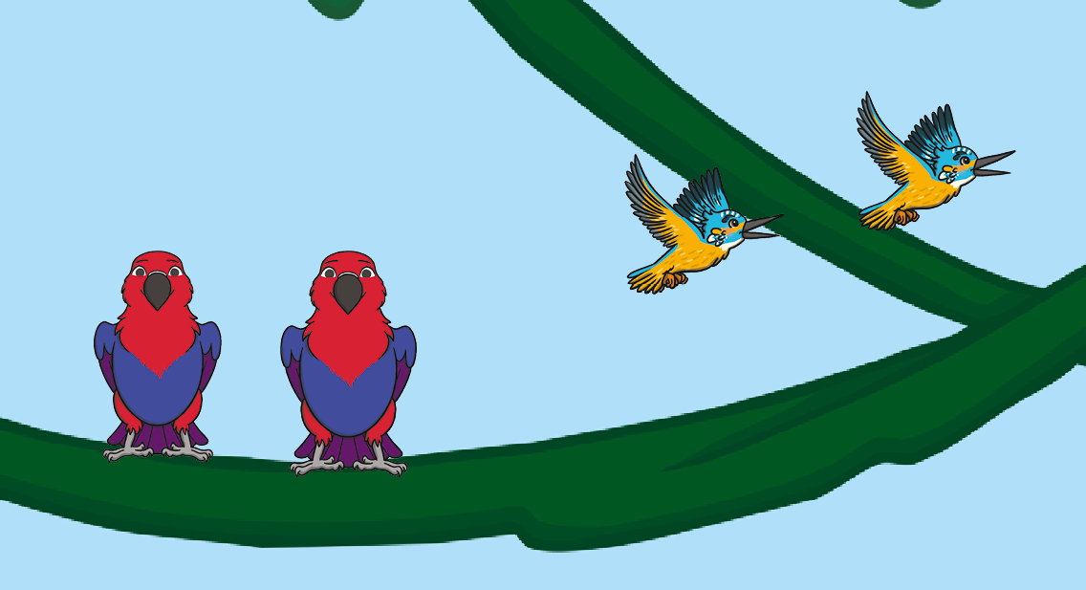
back to the picture
next

Slide 7
back to the picture
next

Slide 8
back to the picture
next

Slide 9
back to the picture
next

Slide 10
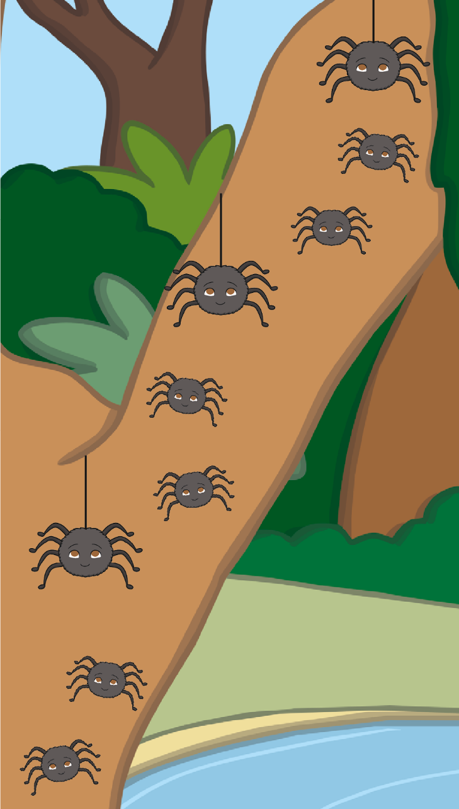
back to the picture
End

